Slide 1
Amazon Elastic Compute Cloud (EC2)

Slide 2
Amazon Elastic Compute Cloud (EC2)
Agenda:
EC2 Introduction
Amazon EC2 Pricing
EC2 Instance Types
EBS Volumes
Types of volumes
2

Slide 3
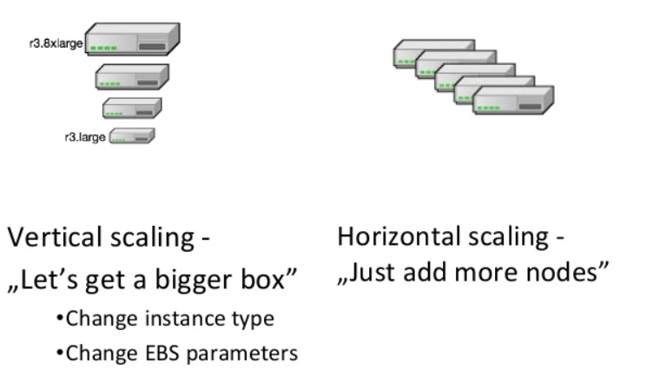
Amazon Elastic Compute Cloud (EC2)
A web service that provides resizable compute capacity in the cloud.
Ways to create EC2 instances -
Create a new instance from AWS management console or CLI.
Use Pre-configured templated Amazon Machine Image (AMI)
Use available AMIs in AWS Marketplace. Creating and sharing your own AMI is also possible via the AWS Marketplace.
Reduces time to provision new server to few minutes.
Reduces resource capacity planning
Allow you to quickly scale capacity, up and down,
as you per your computing requirement
No upfront payment.
Pay only for resources actually consumed
(calculated as instance-hours)
3

Slide 4
Amazon EC2 Pricing
On-Demand Instances
On-Demand instances you only pay for EC2 instances you use.
Let you pay for compute capacity by the hour or by the seconds
No long-term commitments.
Users that prefer the low cost and flexibility of Amazon EC2 without any up-front payment or long-term commitment
Applications with short-term, spiky, or unpredictable workloads that cannot be interrupted
Applications being developed or tested on Amazon EC2 for the first time
4

Slide 5
Amazon EC2 Pricing – Contd.
Reserved Instances
Option to make a low, one-time payment for each instance you want to reserve
Applications with steady state usage
Applications that may require reserved capacity
Reserved Instances provide you with a significant discount compared to On-Demand instance pricing
It could be one or three years contract.
Standard Reserved Instances
significant discount (up to 75%) compared to On-Demand instance pricing
flexibility to change the Availability Zone, the instance size
Convertible Reserved Instances
Additional flexibility, such as the ability to use different instance families, operating systems, or tenancies over the Reserved Instance term
significant discount (up to 54%) compared to On-Demand Instances
5

Slide 6
Amazon EC2 Pricing – Contd.
Spot Instances
Allow customers to bid on unused Amazon EC2 capacity and run those instances for as long as their bid exceeds the current Spot Price.
Spot instance prices are set by Amazon EC2 and adjust gradually based on long-term trends in supply and demand for Spot instance capacity(updated in every 5 minutes)
Spare compute capacity in the AWS cloud available to you at steep discounts
Spot instances are available at a discount of up to 90% off compared to On-Demand pricing
Can be interrupted by EC2 with two minutes of notification when EC2 needs the capacity back
Fault-tolerant and flexible applications, such as test & development environments
To run analytics, machine learning and high-performance computing (HPC) workloads
6

Slide 7
Amazon EC2 Pricing – Contd.
Dedicated hosts
Physical EC2 servers dedicated for your use only.
Dedicated Hosts provide visibility and control by allowing you to place your instances on a specific, physical server
Dedicated Hosts can help you address compliance requirements
reduce costs by allowing you to use your existing server-bound software licenses
7

Slide 8
Amazon EC2 Instance Types
AWS provides a wide selection of EC2 instance types optimized to fit different use cases.
Instance types comprise varying combinations of CPU, memory, storage, and networking capacity
Categories of Instance types:-
General Purpose
Compute Optimized
Memory Optimized
Accelerated Computing
Storage Computing
8

Slide 9
Amazon EC2 Instance Types – Contd.
General Purpose
General purpose instances provide a balance of compute, memory and networking resources, and can be used for a variety of diverse workloads.
e.g. – T2, M5, M4 etc.
Compute Optimized
Compute Optimized instances are ideal for compute bound applications that benefit from high performance processors. Instances belonging to this family are well suited for batch processing workloads, high performance web servers, high performance computing (HPC), scientific modeling, machine learning inference and other compute intensive applications.
e.g. - C5, C4 etc.
Memory Optimized
Memory optimized instances are designed to deliver fast performance for workloads that process large data sets in memory. Optimized for high-performance databases, in-memory databases and other memory intensive enterprise applications
e.g. - X1e, X1, R4 etc.
9

Slide 10
Amazon EC2 Instance Types – Contd.
Accelerated Computing
Accelerated computing instances use hardware accelerators, or co-processors, to perform functions, such as floating point number calculations, graphics processing, or data pattern matching, more efficiently than is possible in software running on CPUs.
e.g.- P3, P2, G3 etc.
Storage Optimized
Storage optimized instances are designed for workloads that require high, sequential read and write access to very large data sets on local storage. They are optimized to deliver tens of thousands of low-latency, random I/O operations per second (IOPS) to applications. Optimized for low latency, very high random I/O performance.
e.g. - H1, I3, D2 etc.
10

Slide 11
Amazon Elastic Block Storage (EBS)
EC2 Virtual server on cloud, EBS Virtual disk on cloud
Persistent block storage volumes for use with Amazon EC2 instances
EBS volume is automatically replicated within its Availability Zone to protect you from component failure
Offers high availability and durability.
Offers various categories needed as per your workloads and price option
scale your usage up or down within minutes
Once attached, you can create file system ,databases on top it or any other way to suit your application need
Allows you to dynamically increase capacity, tune performance, and change the type of live volumes with no downtime or performance impact.
11

Slide 12
EBS Volume Types
Two major categories:-
SSD-backed(Solid State Device) storage for transactional workloads
General Purpose SSD(GP2)
General purpose ,balances for price and performance
Well suited for Boot volumes where the burst capability provides fast instance start-up times
Ratio of 3 IOPS* per GB with up to 10,000 IOPS*
Ability to burst up to 3000 IOPS* for extended period of time for volumes
Provisioned IOPS SSD(I01)
Suited for high I/O intensive applications
Example as large OLTP or NoSQL DBs.
Use if more that 10,000 IOPS* needed, very high performant apps.
Provision up to 32,000 IOPS* per volume
IOPS:- I/O (Input/Output) operations per second
12

Slide 13
EBS Volume Types – Contd.
2. HDD-backed(Hard Disk Drive) storage for throughput intensive workloads
Throughput Optimized HDD (st1)
Low cost HDD volume compare to SSD
Designed for frequently accessed, throughput intensive workloads
Big data, data warehouses, log processing
Cold HDD (sc1)
Lowest cost HDD volume
Use for less frequently accessed workloads
Colder data requiring fewer scans per day
13

Slide 14
References
AWS : https://aws.amazon.com/ec2/
AWS Docs : https://docs.aws.amazon.com/ec2/index.html
14

Slide 15
Thank You

